Slide 1


Pandas
Purwadhika JCDS 13
Final Project Presentation

Slide 2





Our Team
Abdul Hamid
Agatha Putri A.
Juan Antonio S

Slide 3
Table of Contents
01
02
03
04
Background
Data Understanding & Exploration
- Introduction
- Business objective
- Data analysis
- Data preprocessing
Modelling & Evaluation
Conclusion & Recommendation
- Model selection
- Model optimization
- Explainable ML
- Business insight

Slide 4

01
Background

Slide 5


Introduction
We are Data Scientist Team working at a company which active in Big Data and Data Science.
Data Scientists are the core business process
Expand business → recruit more data scientist
Active conduct training about data

Slide 6
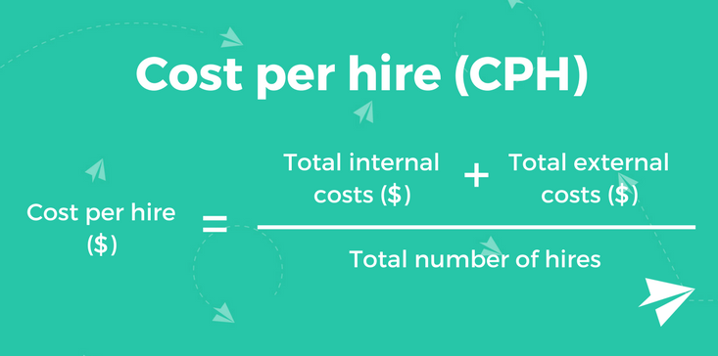

Business Challenges
High Cost per Hire(CPH) for hiring new employee
National average cost per hire (CPH) ranges from $3,033 to $5,611 per year (Deloitte, 2019).
Notes:
https://www.talentlyft.com/en/blog/article/255/recruitment-metrics-cost-per-hire

Slide 7




Background
Job Advertisement
Assessment Cost
Staffing
Cut cost
Predict
Focus
Lower CPH
Notes:
Our company has conducted a training and many people signed up for the course. HR Department wants to hire data scientist among the trainees and they had collected information related to demographics, education and experience from the sign up form.
Aiming to reduce the CPH this year, we are going to use the database from HR to classify which trainee who are looking for a job change and who is not.
By knowing who are looking for a job change, we can focusing our recruitment to them. So that, we can lower the CPH by cutting recruitment cost such as job vacancy poster & advetisement, campus hiring,

Slide 8


Business Objective
​Using the data from training participant, we aim to: Predict which trainees who are looking for a job change to be offered as candidate
Limitation
Main Focus → the willingness of the candidate to change job without considering the qualifications needed to be a data scientist

Slide 9
Analytic Approach
Machine Learning Technique
Performance Measure
Supervised learning (classification)
to categorize binary target
F1 Score
to minimize false negative and false positive

Slide 10
Metric Evaluation
 |  | PREDICTED
 |  | 0 | 1
ACTUAL | 0 | TN | FP
 | 1 | FN | TP
0 : Not looking for a job change
1 : Looking for a job change
Type 1 error : False Positive Consequences: waste of recruitment cost, time and resource
Type 2 error : False Negative Consequences: loss of potential candidate

Slide 11
02
Data Understanding & Exploration
Data Shape:
19158 Rows
14 Columns
The dataset of HR Analysis is downloaded in Kaggle

Slide 12
Data Description
Categorical Features
Numerical Features
Feature​ | Description​
city​ | City code (unknown)​
gender​ | Gender of candidate​
relevent_experience​ | Relevant experience of candidate​
enrolled_university​ | Type of University course enrolled if any​
education_level​ | Education level of candidate​
major_discipline​ | Education major discipline of candidate​
experience​ | Candidate total experience in years​
company_size​ | Number of employees in current employer's company​
company_type​ | Type of current employer​
lastnewjob​ | Difference in years between previous job and current job ​
target​ | Candidates who decide looking for a job change or not​
Feature​ | Description​
enrollee_id​ | Unique ID for candidate​
city_ development _index (CDI)​ | Developement index of the city (scaled). Ranks cities according to their Infrastructure, Waste Management, Health, Education, and City Product​
training_hours​ | training hours completed​

Slide 13
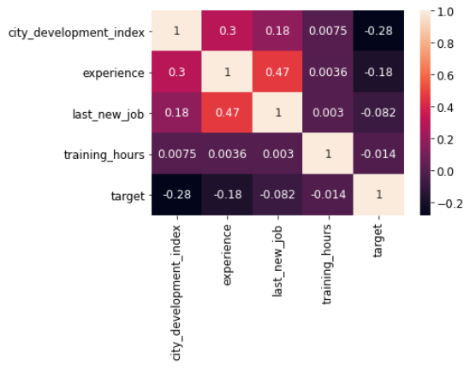
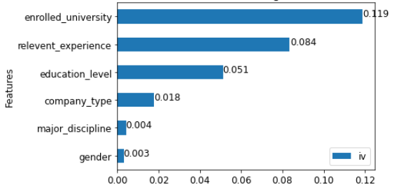
Data Correlation
Information Values
Spearman Correlation

Slide 14
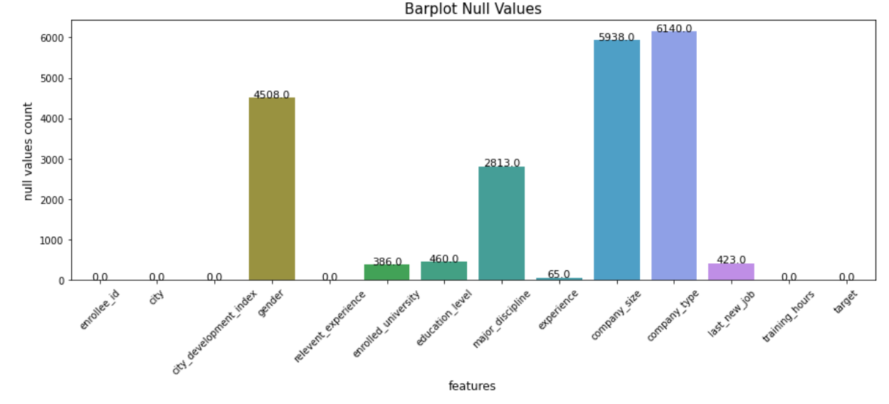
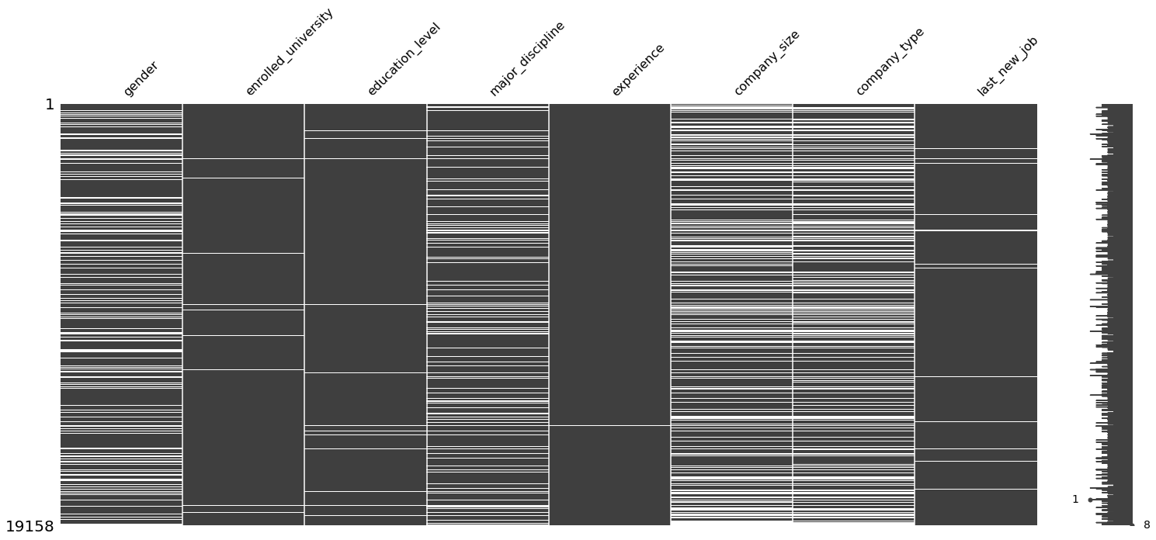
Identify
Missing Values

Slide 15
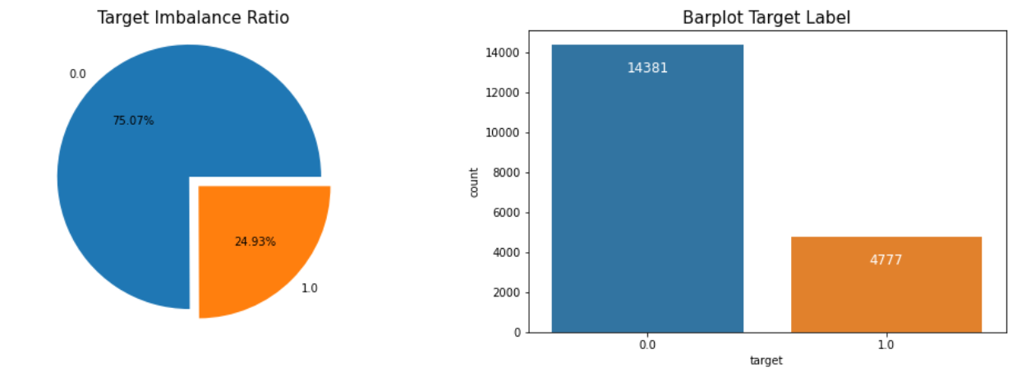
Identify Data Imbalance

Slide 16

Data Analysis

Slide 17
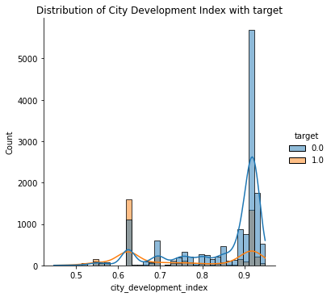
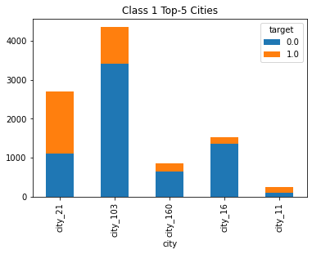
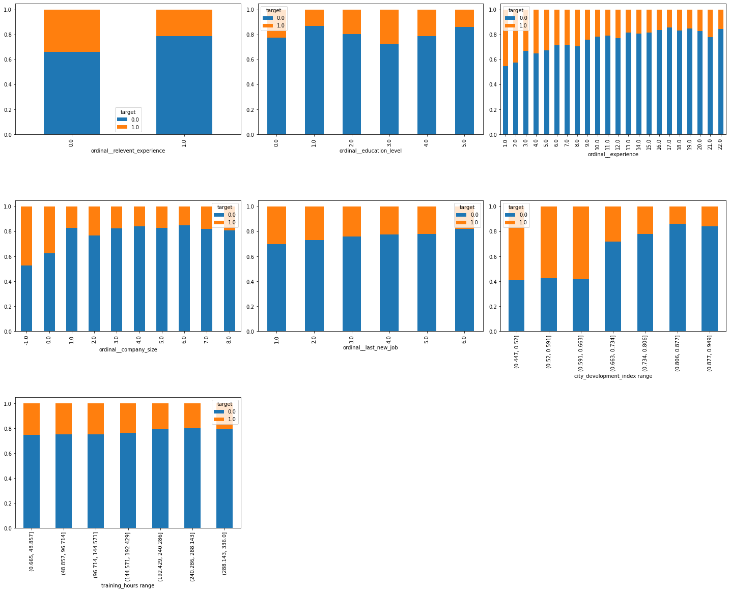
City and CDI
Recommendation
Targeting training and recruitment at cities with low CDI (in general)
Promoting to city_21 where class_1 candidate outnumbered class_0 and to city 103 where most of the candidate come from

Slide 18
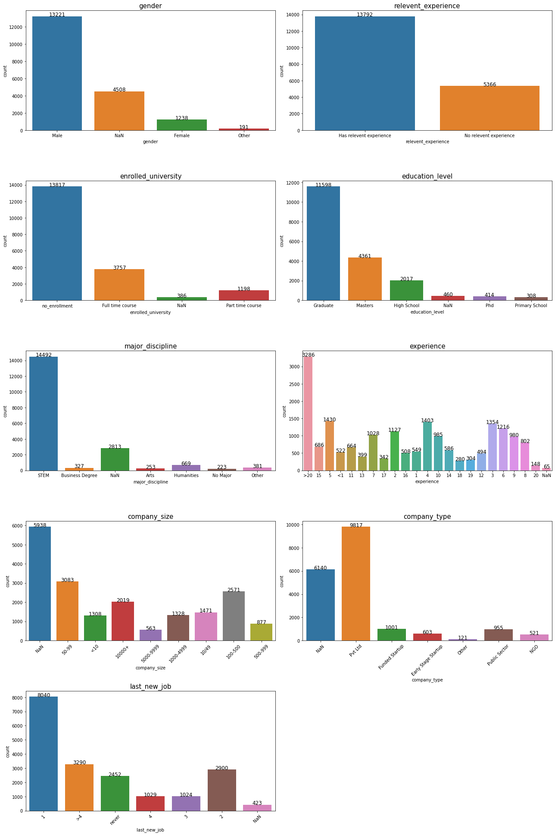
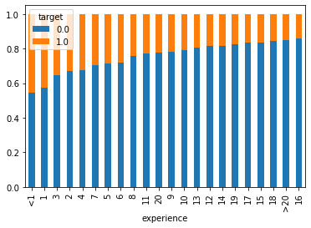
Experience
Recommendation
Data Training is popular for people under 10 years of experience and over 20 years of experience.
Recruiter can focus to people with low job experience.

Slide 19
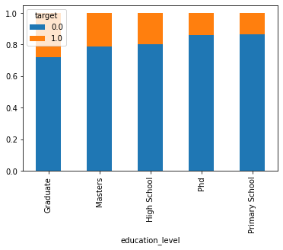
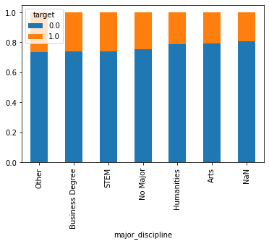
Educational Background

Slide 20
Educational Background
Recommendation
Design training for those who graduate from non-technological degree

Slide 21
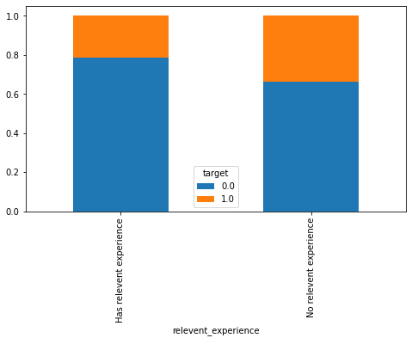
Relevant Experience
Recommendation
Create marketing strategy to gain more non relevant experience candidate to attend the data training

Slide 22
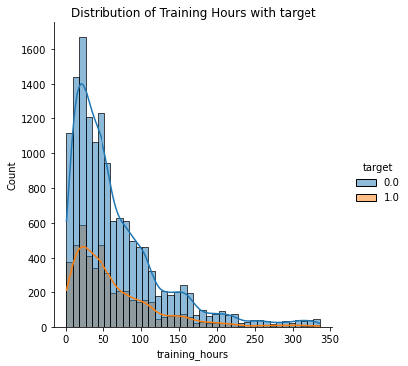
Training Hours
Recommendation
Create more compact trainings with the hope it can attract more people sign up for the training and get in touch with the company.

Slide 23
Data Preprocessing
- Analysis based
- Simple Imputer with Constant
Feature Engineering
Handling
Missing Values
- One Hot Encoder
- Ordinal Encoder
Feature Selection
Correcting Inconsistency
- Drop 'gender'
- Correcting punctuation and spelling

Slide 24
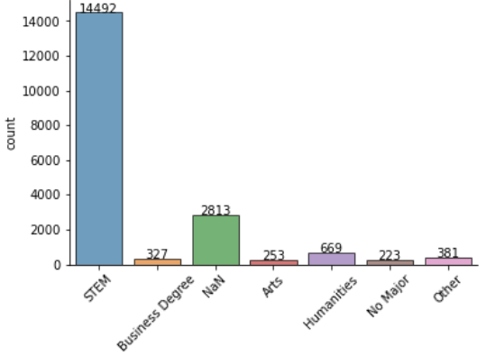
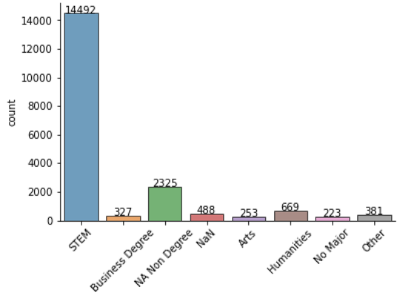
Handling Missing Values: Analysis based
1. Major Discipline
High school and primary school education level = NAN → NA Non Degree
Before Processing
After Processing
→

Slide 25
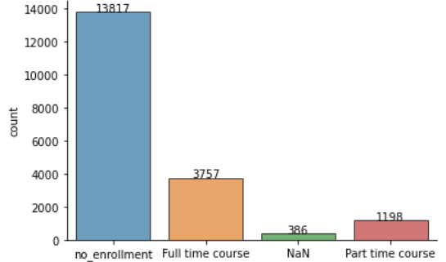
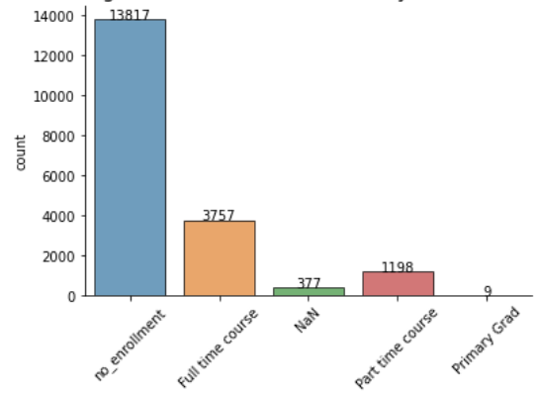
Handling Missing Values: Analysis based
2. Enrolled University
Primary School education_level in enrolled_university = NaN → Primary Grad.
Before Processing
After Processing
→

Slide 26
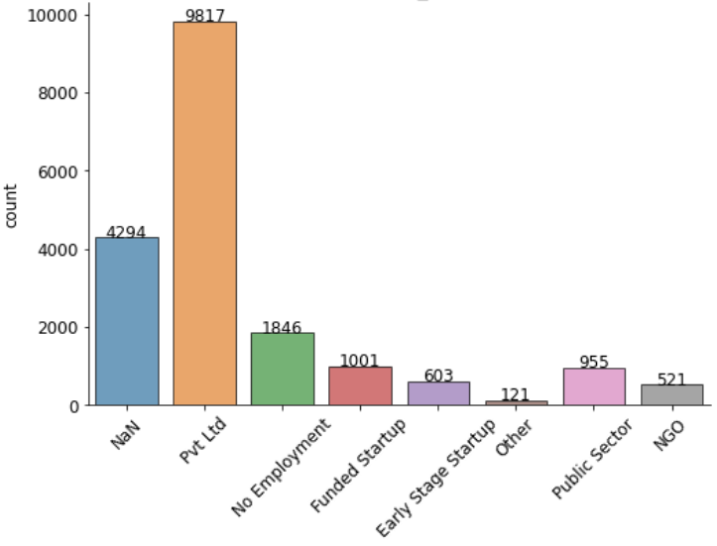
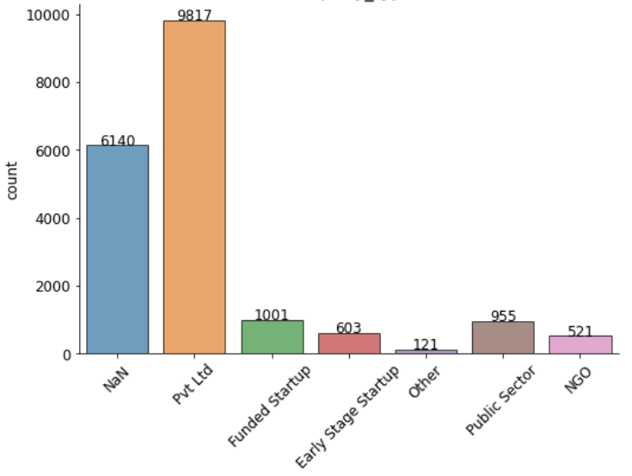
Handling Missing Values: Analysis based
3. Company Type
`Full time course` in `enrolled_university` = `NaN` → `No Employment`.
Before Processing
After Processing
→

Slide 27
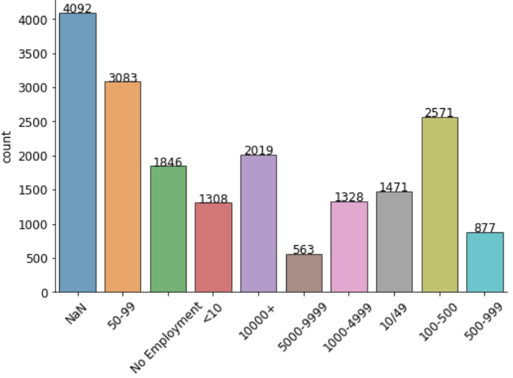
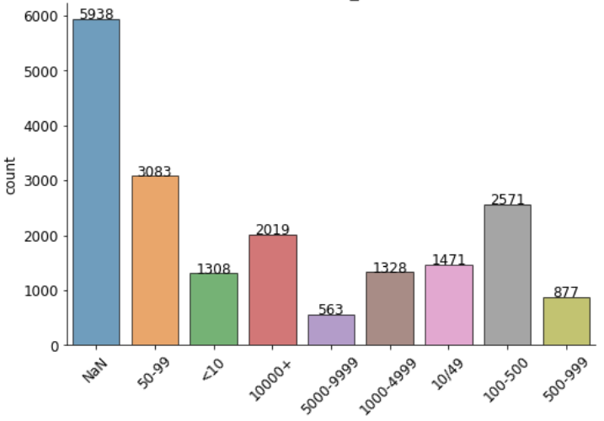
Handling Missing Values: Analysis based
4. Company Size
`Full time course` in `enrolled_university` = `NaN` → `No Employment`.
Before Processing
After Processing
→

Slide 28
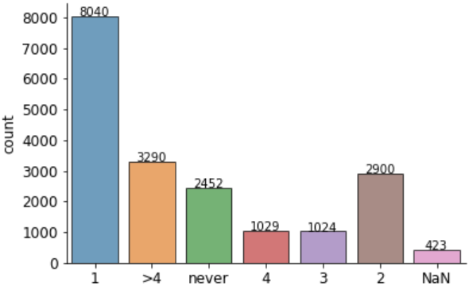
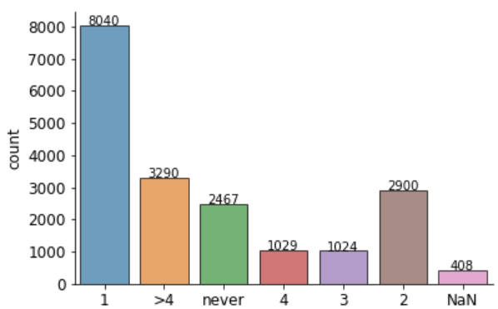
Handling Missing Values: Analysis based
4. Last New Job
<1 year of experience and Full time course enrolled_university = NaN → never
Before Processing
After Processing
→

Slide 29
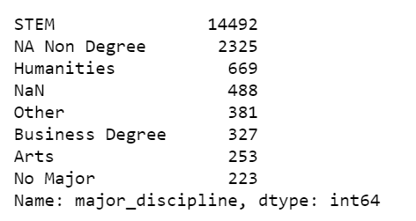
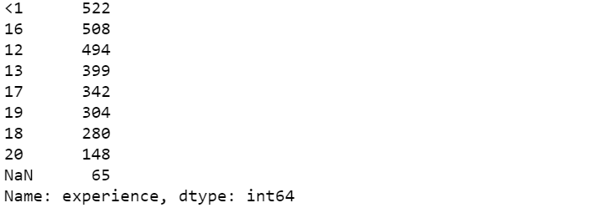
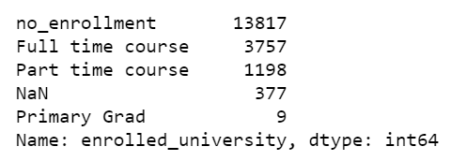
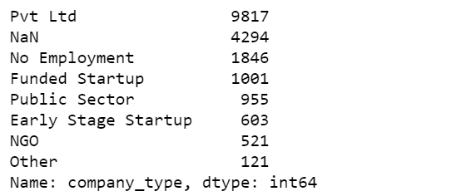
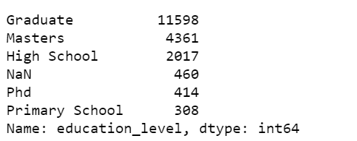
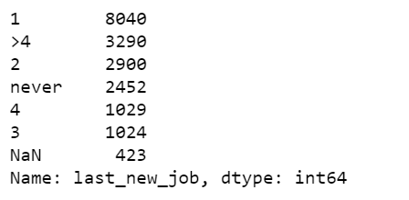
Handling Missing Values: Simple Imputer with Constant
Others
The rest of NaN data will be imputed by constant value ‘Not Provided’​

Slide 30
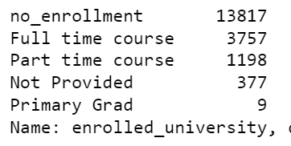
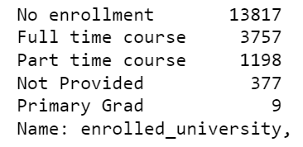
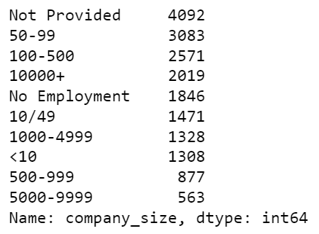
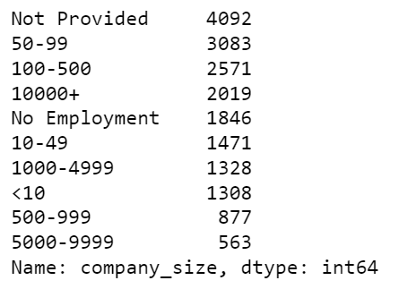
Correcting Inconsistency
Before Processing
After Processing
→
→

Slide 31
Feature Engineering: Nominal Categorical Encoding
→
company_type,
Number of unique data : 8
major_discipline,
Number of unique data : 8
enrolled_university
Number of unique data : 5
→
Onehot Encoding
→
→
Ordinal Encoding
(to avoid creating large tables that would consume too much memory and more interpretable )
city
Number of unique data : 113

Slide 32
Feature Engineering: Ordinal Categorical Encoding
No | relevent_experience | education_level | company_size | last_new_job | experience
0 | No relevent experience | Primary School | <10 | never | <1
1 | Has relevent experience | High School | 10-49 | 1 | 1
2 |  | Graduate | 50-99 | 2 | 2
3 |  | Masters | 100-500 | 3 | 3
4 |  | Phd | 500-999 | 4 | 4
5 |  |  | 1000-4999 | >4 | 5
6 |  |  | 5000-9999 |  | 6
7 |  |  | 10000 |  | …
22 |  |  |  |  | >21

Slide 33
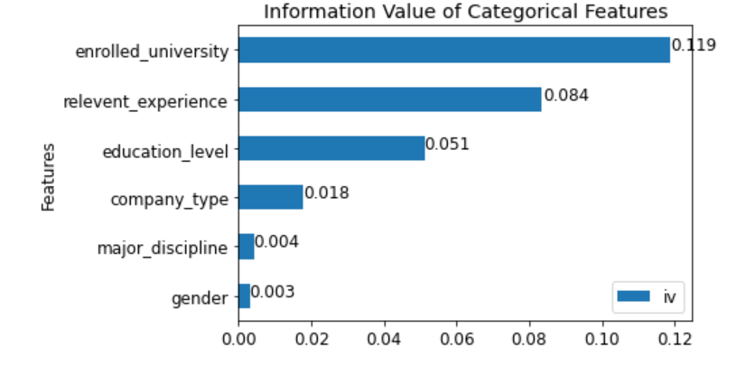
Feature Selection
We will drop gender because not only it has low information value, because it may lead to discriminatory result
We keep major_discipline because it may contain information for other features

Slide 34
03
Modelling & Evaluation

Slide 35
Modelling Steps
Model Selection
Hyperparameter Tuning
Data Splitting
Imbalance Data Handling
Finalize the model

Slide 36
Data Splitting
Train set
80%
Test set
20%
Before we do model selection, we split the data with 80:20 train:test proportion using stratify=y condition to avoid imbalance data splitting

Slide 37
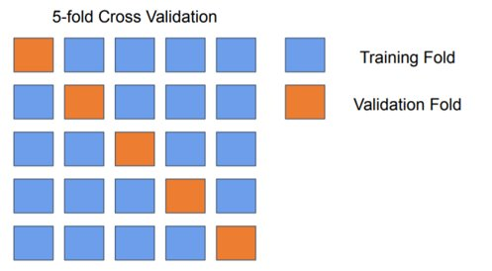
Model Selection
With 5-fold Cross Validation, we try to choose among these models that have the highest mean score with the lowest standard deviation.
Logistic Regression
K-Nearest Neighbors
Decision Tree
Random Forest
XGBoost
Catboost

Slide 38
Model Selection
Model | CV Mean | CV Sdev
Catboost | 0.578 | 0.001
XGBoost | 0.539 | 0.016
Random Forest | 0.520 | 0.005
Decision Tree | 0.477 | 0.033
KNN | 0.390 | 0.014
Logistic Regression | 0.318 | 0.012
The mean score on the table is mean F1 Score. Because we try to minimize both false positive and false negative.
Since the dataset contains more categorical features, Catboost got the best performance than other models

Slide 39


Model Selection
Based on the above benchmark, we can see that CatBoost is the top performing model with Mean F1 score of 0.577781 during the 5-fold cross validation. ​
​
Therefore, we will create a Catboost model for the next steps.​
​

Slide 40
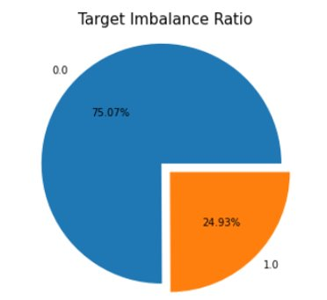
Imbalance Data Handling
This dataset has imbalance target data with the number of label 0 is 3 times more than label 1.
We try to improve the model by choosing one of this technique:
Oversampling ​(SMOTE-NC)​
Penalized Model ​(class weight = balanced)​
​

Slide 41
Imbalance Data Handling
We create all the models using 5-fold cross validation
Although SMOTE give the higher cross validation score, we see that the model is overfitting. It’s test score is lower than balanced class weight
Model | CV Score | Test Score
Class Weight | 0.631 | 0.619
SMOTE-NC | 0.809 | 0.596
Therefore, we use Balanced Class Weight as imbalance handling method for the next steps

Slide 42
Hyperparameter Tuning
We used grid search method with 5-fold cross validation. These are the hyperparameter ranges that we try to choose to optimize the model
Depth​ | 3, 4, 5, 6, None​
loss_function​ | 'Logloss', 'CrossEntropy', None​
l2_leaf_reg​ | np.logspace(-20, -19, 6)​
n_estimators​ | 100​

Slide 43
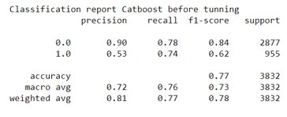
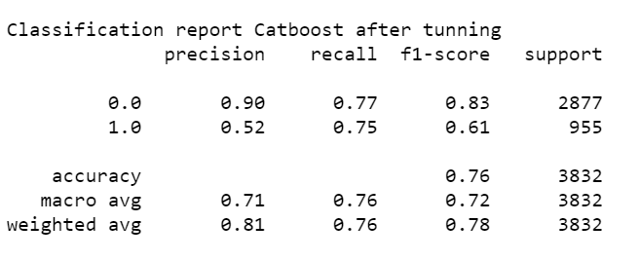
Hyperparameter Tuning
F1 score, recall, precision on class 1 as well as accuracy is decreasing after tuning. This is because Catboost Classifier’s default parameters give better result most of the time.
Model​ | F1 Score​
Before Tuning​ | 0.619​
After Tuning​ | 0.613​

Slide 44
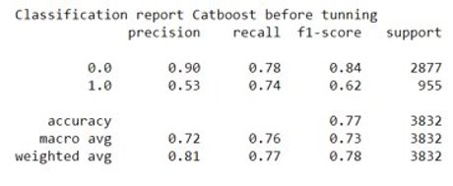
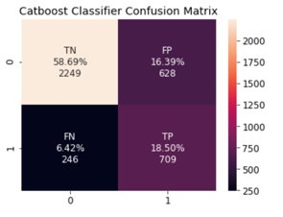
Final Model
Our final model is CatBoostClassifier with Balanced Class Weights and Without Tuning

Slide 45
04
Conclusion and Recommendation

Slide 46
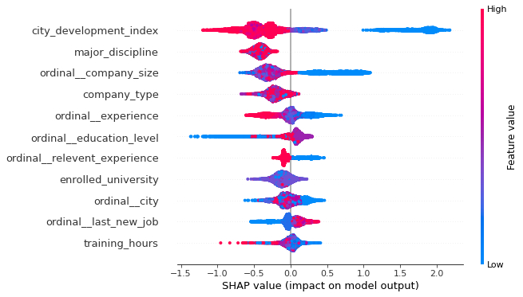
SHAP Summary Plot
Notes:
1. Domicile Factor Candidate that comes from low city_development_index has higher chance to look for a new job compared to the higher one.
2. Experience Factor Candidate that has lower experience has higher chance to look for a new job, compared to those who has higher experience.
3. Education Factor Candidate that has higher education_level has higher chance to look for a new job, compared to those who has lower education_level.
4. Relevant Experience Factor Candidate that has No relevant experience has higher chance to look for a new job, compared to those who Has relevant experience
5. Last New Job Factor Candidate that has higher last_new_job has higher chance to look for a new job.

Slide 47
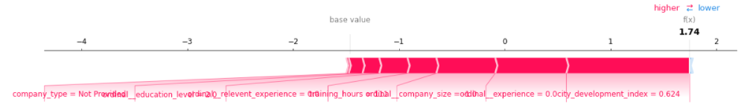
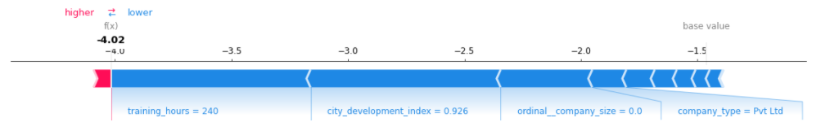
Class 1 Characteristics
Class 0 Characteristics
Notes:
The observation in which our model predict the candidate that has the highest probability to look for a job change on X-test, has company_size = -1 (Not Provided), company_type = No Employment,city = 5,relevent_experience = 0 (no relevent experience),enrolled_university = 1 (Full time course), experience = 4 (3 years),last_new_job = 3 (3 years), and education_level = 2 (Graduate)

Slide 48
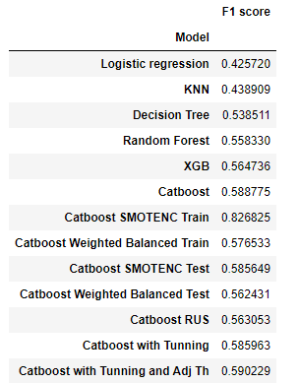
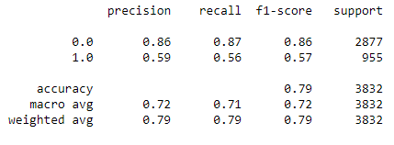
Conclusions
Classification report final model
Notes:
We tried 5 models and got the result with high marks (strong learner) which are Catboost, Xgboost, Random forest, KNN, and Logistic regression. Since the dataset contains more catagorical than numerical features, Catboost got the best performance then other models because it is very good to handle catagorical features. So, we continued to use Catboost for the next step.
This dataset has imbalance label data with the number of label 0 is 3 times more than label 1. To handle it, we compared 2 methods, which are SMOTENC and balanced class weight. The result is balanced class weight gives better performance than SMOTENC because SMOTENC gives overfitting result. It can happen because SMOTENC replicate the data and it will get good result only in training set.
To optimize the model, we did hyperparameter tunning using grid search and found default model gave better performance than model after tunning. Another advantages of Catboost is that it can get best result only using default parameters. To make our model is explainable and interpretable, we used SHAP method. With SHAP, we can answer the problem to help HR Departments to reach their goals as mentioned in the problem statement.

Slide 49
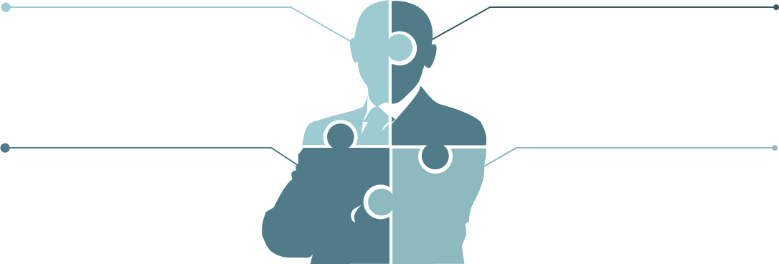
Conclusions
Domicile Factor
Experience Factor
Low City Development Index
Low Experience
Education Factor
Last New Job Factor
High Education level
High Last New Job
Relevant Experience Factor
No Relevant Experience

Slide 50

Recommendations
HR can focus to offer the job for candidates who live in city_160 and city_21
HR can develop data collecting method to get another features for analyzed and better data quality
HR can make the training more compact
Data scientist can continue the project to make machine learning to determine qualification of candidate
HR Departments must aware about total candidates to screening

Slide 51


Thanks!
Purwadhika JCDS13
Pandas Team
Abdul Hamid
Agatha Putri A
Juan Antonio S
Github Repository
CREDITS: This presentation template was created by Slidesgo, including icons by Flaticon, infographics & images by Freepik and illustrations by Stories

